Slide 1
Employee Data Analysis using Excel
STUDENT NAME:
REGISTER NO:
DEPARTMENT:
COLLEGE
JAYASREE G
Valliammal college for women
312209992
B.com General

Slide 2
PROJECT TITLE
Employee Performance Analysis using Excel

Slide 3


AGENDA
Problem Statement
Project Overview
End Users
Our Solution and Proposition
Dataset Description
Modelling Approach
Results and Discussion
Conclusion
3/21/2024 Annual Review

Slide 4

PROBLEM STATEMENT
Creating a problem statement using Excel involves defining a specific issue or challenge that can be analyzed or solved using Excel's data analysis tools. Below is a structured approach to crafting a problem statement suitable for Excel analysis:

Slide 5

PROJECT OVERVIEW
Creating a project overview in Excel is a great way to visualize and manage the various elements of a project. A project overview typically includes key details like the project timeline, milestones, tasks, responsible parties, and status updates. Here's how you can set up a project overview using Excel:
.

Slide 6

WHO ARE THE END USERS?
The end users of Excel can vary widely depending on the context, but generally, they include anyone who needs to manage, analyze, or present data. Here’s a breakdown of common end users across different fields:

Slide 7

OUR SOLUTION AND ITS VALUE PROPOSITION
When you're using Excel to craft a solution and define its value proposition, you're essentially leveraging Excel's powerful data analysis, visualization, and management capabilities to address specific needs. Here's how you can outline your solution and its value proposition using Excel:

Slide 8
Dataset Description
When describing a dataset in Excel, it's important to clearly communicate the contents, structure, and purpose of the data. This helps users understand what the dataset includes, how to use it, and any limitations or considerations that apply. Here's how you can set up a dataset description in Excel:

Slide 9
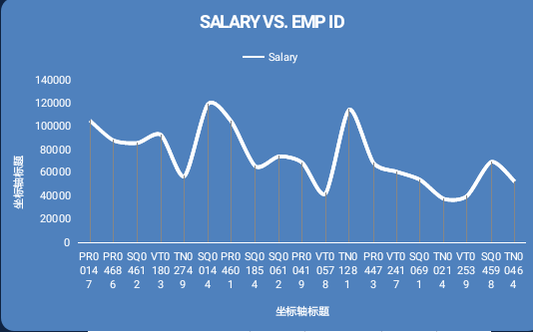

THE "WOW" IN OUR SOLUTION
3/21/2024 Annual Review
9

Slide 10
MODELLING
Modeling using Excel involves creating a structured representation of real-world scenarios, systems, or problems to analyze outcomes, make decisions, or forecast future trends. Excel is widely used for financial, operational, statistical, and predictive modeling due to its flexibility and powerful calculation tools. Here's how you can approach different types of modeling in Excel
10

Slide 11
RESULTS
11

Slide 12
conclusion
When crafting a conclusion in Excel, especially after conducting data analysis, modeling, or creating reports, it's important to summarize the insights and provide clear, actionable takeaways. Here’s how you can effectively write and present a conclusion using Excel

